Slide 1
Advanced Pentaho Data Integration
James O’Reilly

Slide 2
Agenda
PDI as a Data Source
Data Streaming
Metadata Injection
Scalability
Project Management

Slide 3
Pentaho Data Integration Data Sources
PDI as the Datasource
James O’Reilly

Slide 4
Agenda
Pentaho Data Integration Reporting step
Pentaho Report Designer
CDA (Community Data Access)
Data Service
Machine Learning

Slide 5
PDI as a Datasource

Slide 6
PDI Reporting Step
This step renders a report designed by Pentaho Report Designer, a prpt file. The various output options available to the Pentaho Reporting engine are exposed (PDF, HTML, Excel, ...).
Used in ETL workflows where you need to:
eMail a report
Output the report in various formats
Useful when the report has parameters

Slide 7
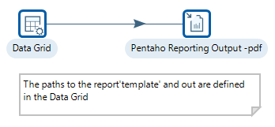
Guided Demo: Pentaho Reporting Step
Open the Transformation:
C:\Pentaho\design-tools\data-integration\reports\tr_pentaho_reports_pdf.ktr
Output is located at:
C:\Pentaho\design-tools\data-integration\reports\pdf\Inventory List.pdf

Slide 8
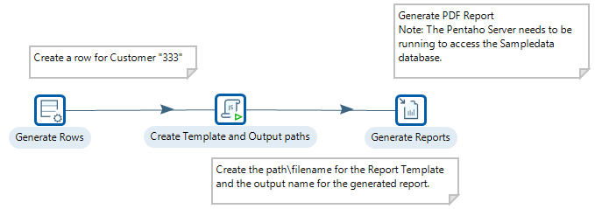
Exercise: Invoice
A Report Designer report acts as a ‘template’ for the Invoice report.
The ‘template’ passes a parameter: CustomerNo which has to be mapped to Invoice Customer Number in Transformation.

Slide 9
Exercise: Invoice
MJV step sets the path to the ‘template’ and the path to the Invoice report output.
The Generate Reports step maps the parameters and determines output type.

Slide 10
Report Designer

Slide 11
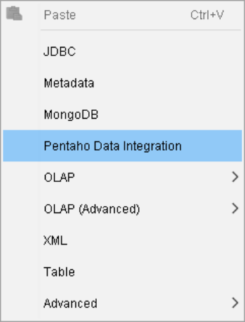
Report Designer
One of the many datasources that can be defined in Report Designer is:
Pentaho Data Integration
Once the step within the Transformation has been defined as your dataset, then the data elements can be used in your report.
First let’s look at the Transformation we’re going to use as a Datasource…

Slide 12
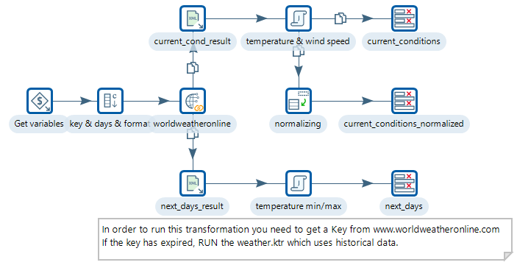
Guided Demo: Report Designer - PDI
Open the Transformation:
C:\pentaho\design-tools\data-integration\reports\ tr_weather_forcast_api.ktr
The ktr has 3 variables:
CITY
SPEED
TEMP

Slide 13
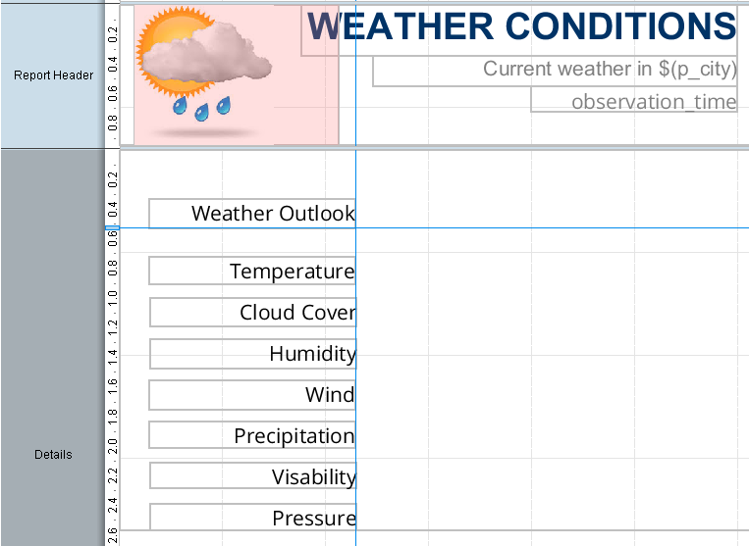
Guided Demo: Report Designer - PDI
Open the report:
C:\pentaho\design-tools\data-integration\reports\template\Forecast.prpt in Report Designer
You need to define 2 report parameters:
p_city
p_temp
These will be mapped to:
CITY
TEMP
from the KTR

Slide 14
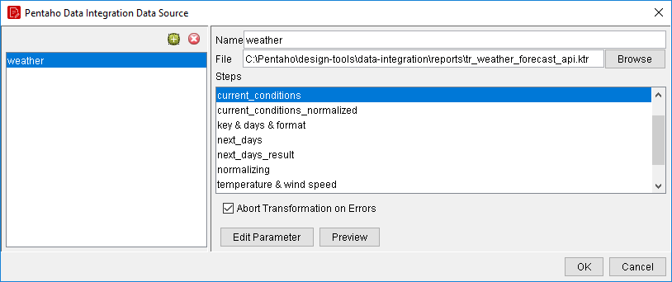
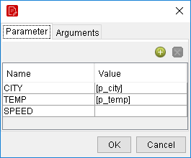
Guided Demo: Report Designer - PDI
Define PDI as datasource
Configure ‘Weather’ Query
Map Parameters

Slide 15
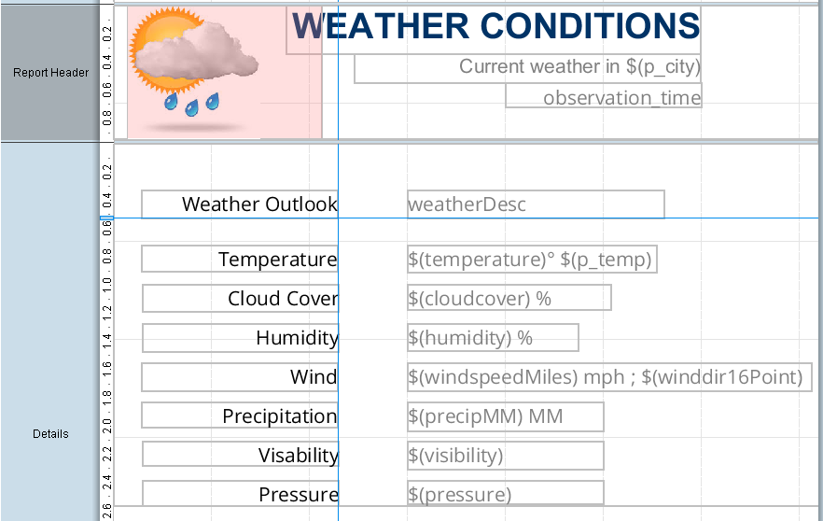
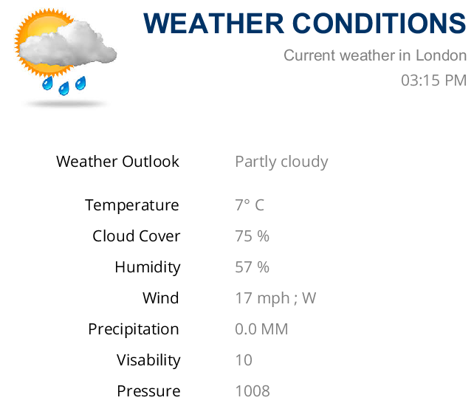
Guided Demo: Report Designer - PDI
Drag and Drop data element fields onto report

Slide 16
Community Data Access

Slide 17
Community Data Access
When displaying data in a dashboard (CTOOLS), you need to be able to extract the data from multiple datasources, without having to write code.
Community Data Access (CDA) provides a data abstraction layer for multiple kinds of data sources wrapped as web services.
It's very simple to use—to create a data source, and you should use an attribute type of kettle.TransFromFile. When setting the connection, you will need to specify the following properties:
KtrFile: This is used to specify the path and name of your transformation.
Variables: This is used to specify the mapping between kettle parameters and the parameters used in the dashboard.

Slide 18
Guided Demo: CDA
Let’s look at an existing CDA data connection:
In Notepad++ open:
C:\Pentaho Training\DI 1500\Module 2 - Data Sources\Lesson 2 – CDA\weather.cda

Slide 19
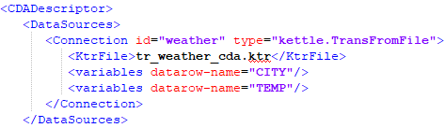
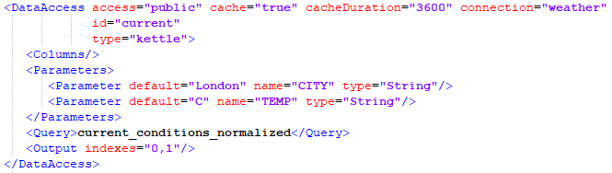
Guided Demo: CDA
The first block defines the datasource:
The second block defines the Queries:
Query for current conditions

Slide 20
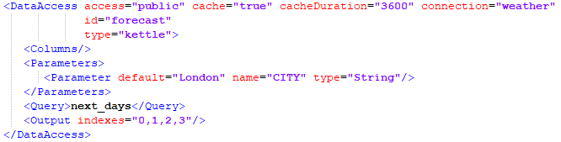
Guided Demo: CDA
The first block defines the datasource:
The second block defines the Queries:
Query for next days

Slide 21
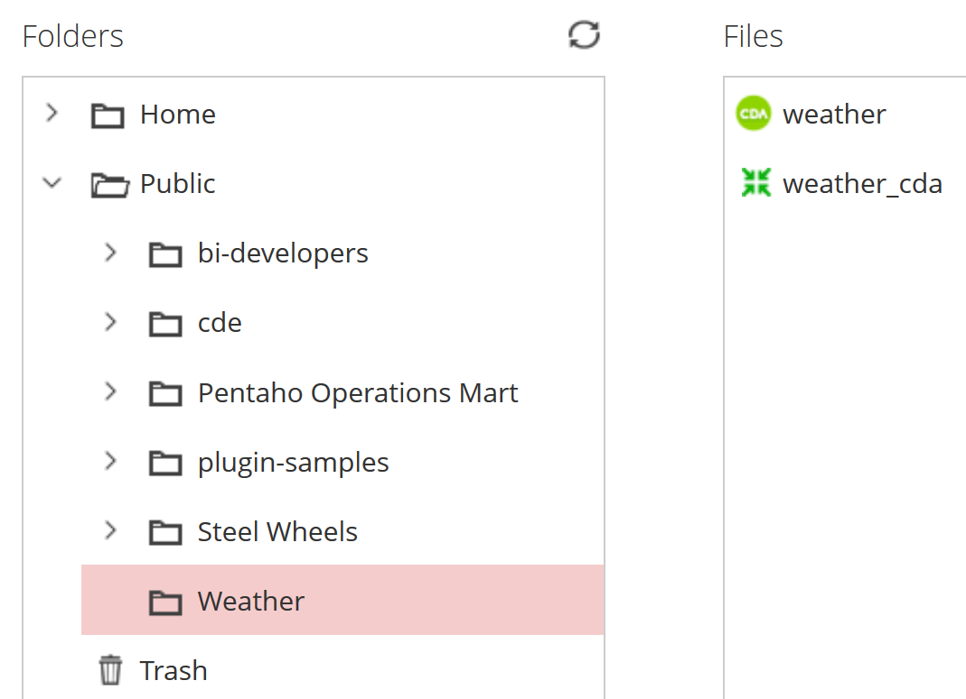
Guided Demo: CDA
Create a Public ‘Weather’ folder
Upload KTR and CDA into the folder

Slide 22
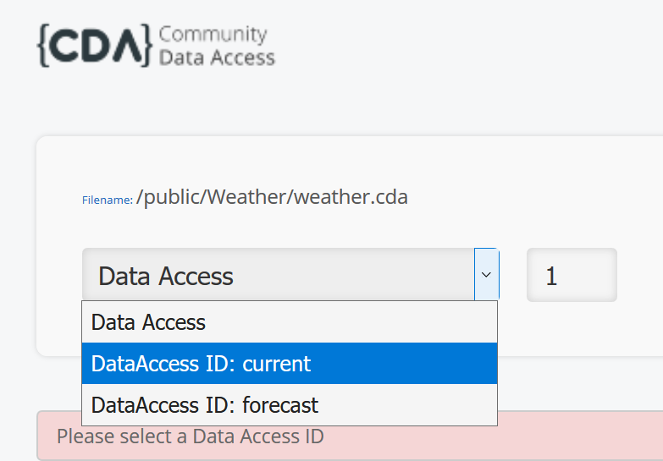
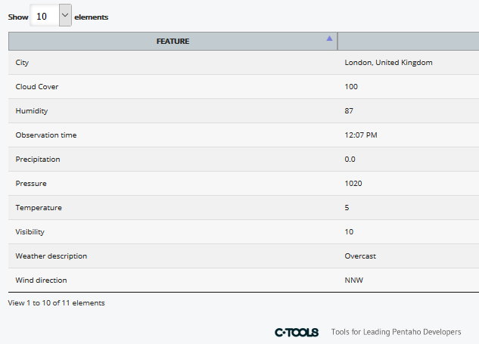
Guided Demo: CDA
Highlight weather.cda file and under ‘File Actions’ > Open in a new window

Slide 23
Data Services

Slide 24
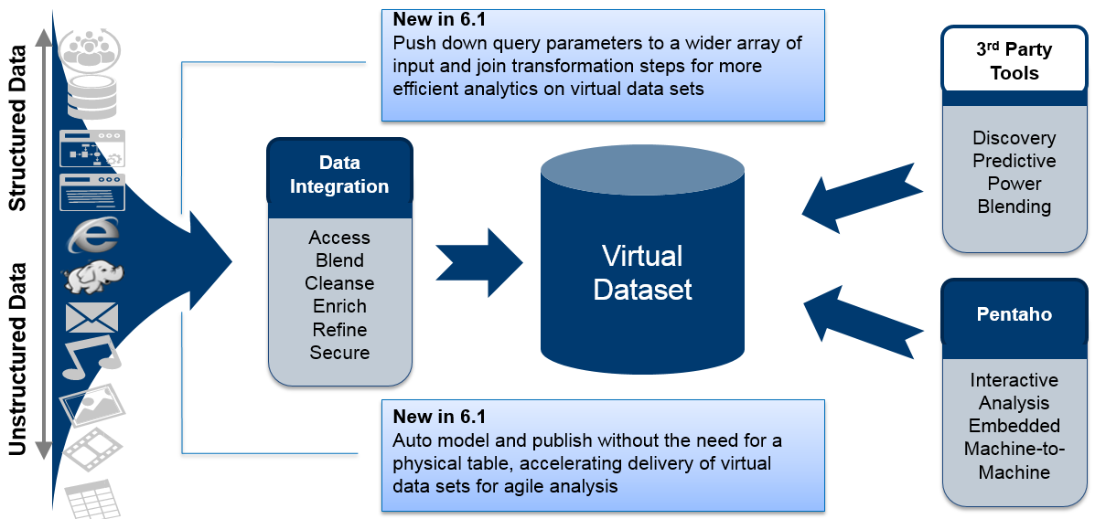
Data Services
Prototyping a data model can be time consuming, particularly when it involves setting up databases, creating the data model and setting up a data warehouse, then negotiating accesses so that analysts can visualize the data and provide feedback.
The KTR step is exposed
as a virtual table.
The virtual table is JDBC
Compliant.

Slide 25
Guided Demo: DS_Twitter
In this demo you’re going to access a ‘Twitter Feed’.
Create a Folder called ‘Data Services’.
Drag onto the canvas a CSV File input step
Save as ds_twitter.ktr in the Pentaho Repository
OPTION | VALUE
Step name | Read Twitter Data
Filename | C:\Pentaho Training\DI 1100 - Advanced PDI\Module 2 - Data Sources\Lesson 4 - Data Services\Guided Demo\ Mar_22_11_57_39 AM_2017_CET_Pentaho_TwitterData.csv
Delimiter | , comma
Lazy Conversion | check
Header row present | Check
File encoding | Windows 1250

Slide 26
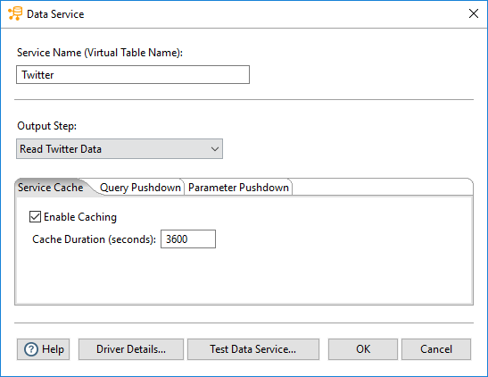

Guided Demo: DS_Twitter
Define the Data Service

Slide 27
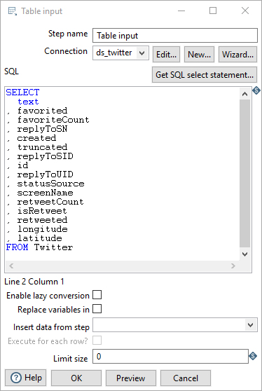
Guided Demo: DS_Twitter
Finally.. Connect to the Data Service
Drag a Table Input onto the canvas
You will need to create a connection

Slide 28
Machine Learning

Slide 29
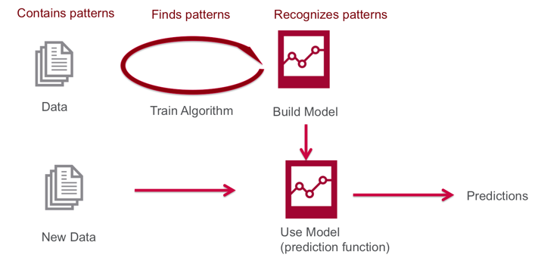
Machine Learning
Machine Learning (ML) uses algorithms to find patterns in data, and then uses a model that recognizes those patterns to make predictions on new data.

Slide 30
Machine Learning - Software
Python is an interpreted, object-oriented, high-level programming language with dynamic semantics.
RStudio is an integrated development environment (IDE) for R. It includes a console, syntax-highlighting editor that supports direct code execution, as well as tools for plotting, history, debugging and workspace management.
Anaconda is a freemium open source distribution of the Python and R programming languages for large-scale data processing, predictive analytics, and scientific computing, that aims to simplify package management and deployment

Slide 31
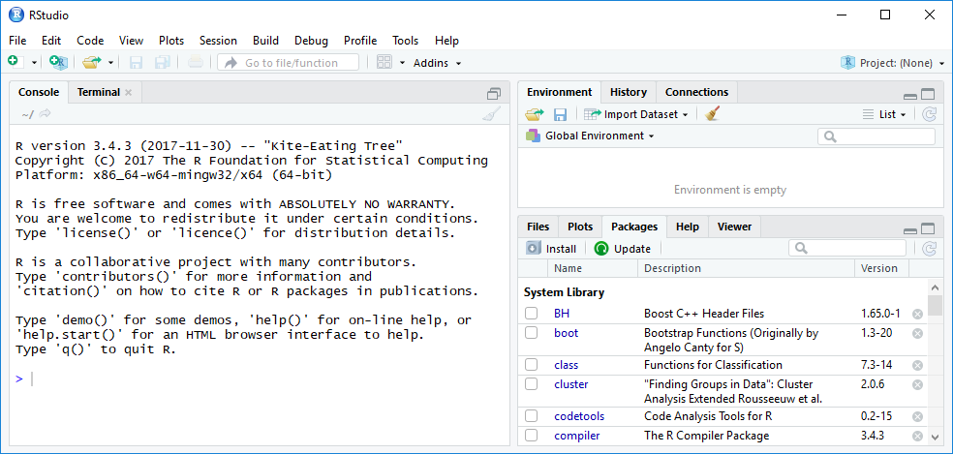
Guided Demo: RStudio
Enter Ctrl+L will clear the screen
Then at the prompt enter (without the comment):
# We can use the print() function
> print("Hello World
[1] "Hello World!"

Slide 32
Guided Demo: Credit Card Fraud
A direct retailer wants to reduce losses due to orders involving fraudulent use of credit cards. Orders are accepted via phone and their web site and goods ship directly to the customer.
A relational database stores basic customer details such as:
customer name
date of birth
billing address
preferred shipping address.
As orders come in, they are stored in a database.
A report of historical instances of fraud is contained in a CSV spreadsheet.

Slide 33
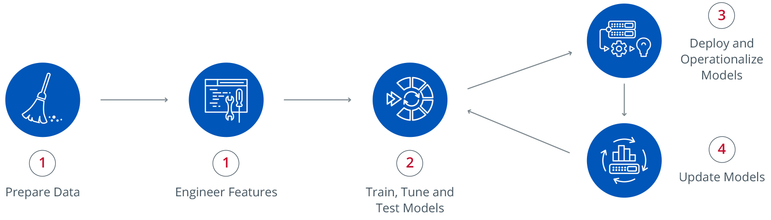
Guided Demo: Credit Card Fraud
The sequence of the phases is not strict and moving back and forth between different phases is always required.

Slide 34
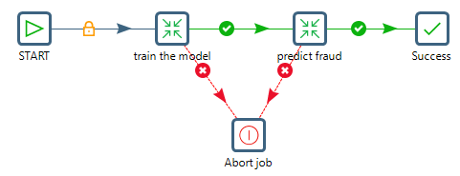
Guided Demo: Credit Card Fraud
The model that will be used: Random Forest
Open the following main Job:
C:\Pentaho Training\DI 1500\Module 2 - Data Sources\Lesson 4 - Machine Learning\Exercise - Credit Card\jb_fraud_main_job.kjb

Slide 35
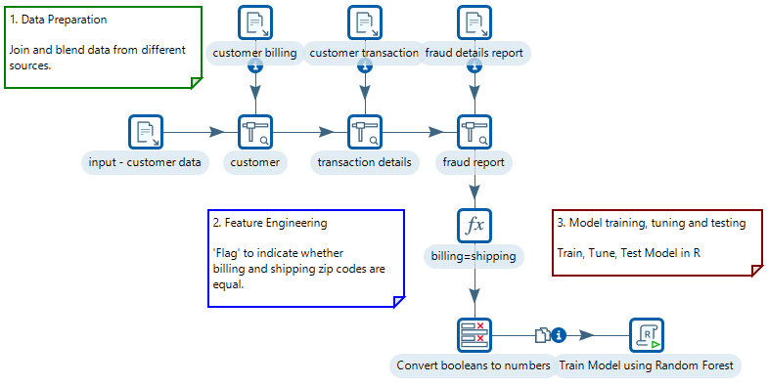
Guided Demo: Credit Card Fraud -TRAIN
Right mouse click on the tr_train_model_fraud.ktr Transformation and select: Open Referenced Object > Transformation

Slide 36
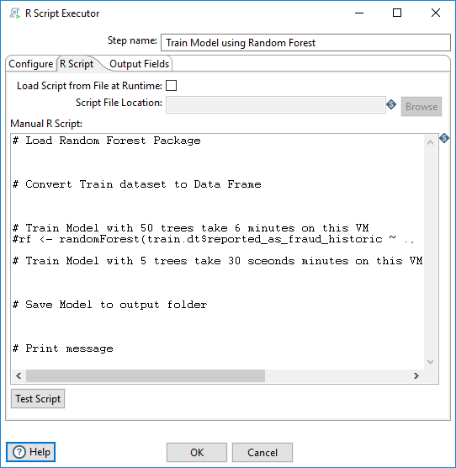
Guided Demo: Credit Card Fraud
To configure the model for ‘training’:
Install the randomForest algorithm
Double-click on R Script step
Add code snippets
Run the KTR to Train the model.
The output folder cannot have any spaces. The \ also need to be escaped with \\.

Slide 37
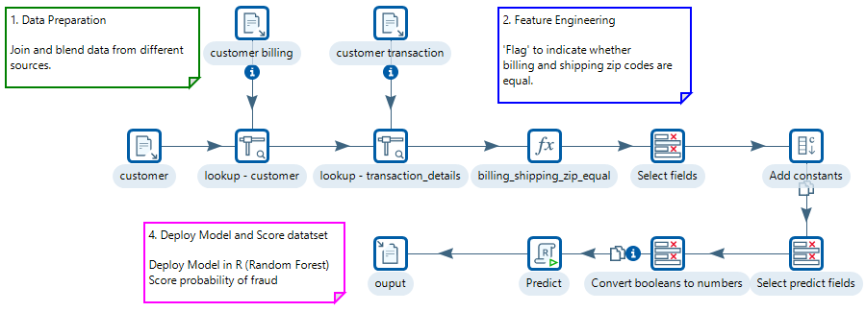
Guided Demo: Credit Card Fraud - PREDICT
Right mouse click on the tr_predict_model_fraud.ktr Transformation and select: Open Referenced Object > Transformation

Slide 38
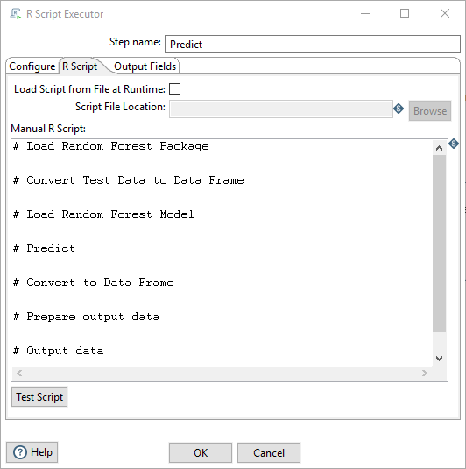
Guided Demo: Credit Card Fraud
To configure the model for ‘predictive’:
Double-click on R Script step
Add code snippets
Run the KTR to Predict.
The output folder cannot have any spaces. The \ also need to be escaped with \\.

Slide 39
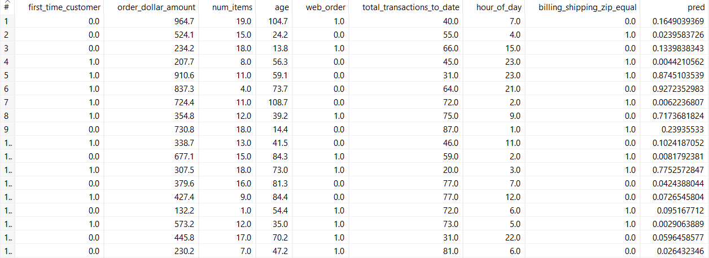
Guided Demo: Credit Card Fraud
RUN the jb|_fraud_main_job_v1.kjb
The predictive results from the model are output to:
C:\Pentaho Training\DI 1500\Module 2 - Data Sources\Lesson 4 - Machine Learning\Exercise - Credit Card\output\predictive.csv

Slide 40
Summary

Slide 41
Summary
Pentaho Data Integration Reporting step
Pentaho Report Designer
CDA (Community Data Access)
Data Service
Machine Learning

Slide 42
Thank You

